Slide 1

CHM 257
Professor
Hilkka
Kenttämaa
hilkka@purdue.edu
Charlie
(Miniature
Golden
Doodle),
5 months

Slide 2
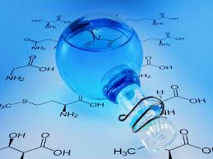
Organic chemistry: The study of the compounds of carbon.
Over 10 million organic compounds have been identified.
About 1000 new ones are discovered or synthesized and identified each day!
C is a small atom
It forms single, double, and triple bonds.
It is intermediate in electronegativity (2.5).
It forms strong bonds with C, H, O, N, and some metals.

Slide 3
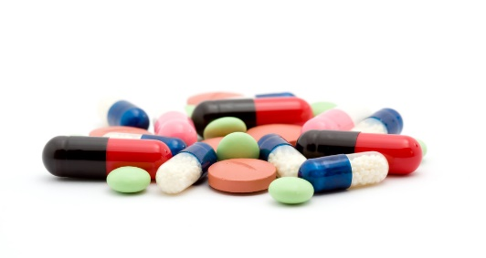

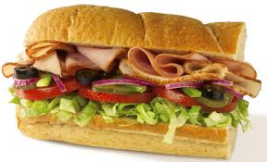

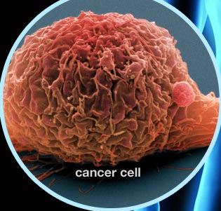
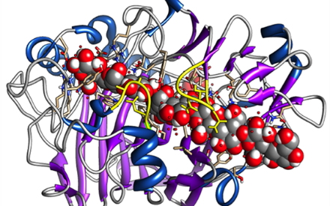
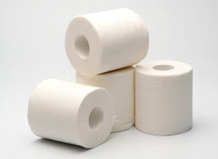

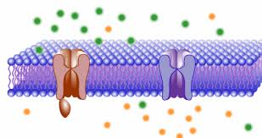
CHM 257
GOAL: Gaining basic understanding on the principles of organic chemistry
(chemistry of carbon compounds)
Drugs
Fuels
Food
Clothes
Aging
Cancer
Enzymes
Paper
Membranes
Plants

Slide 4
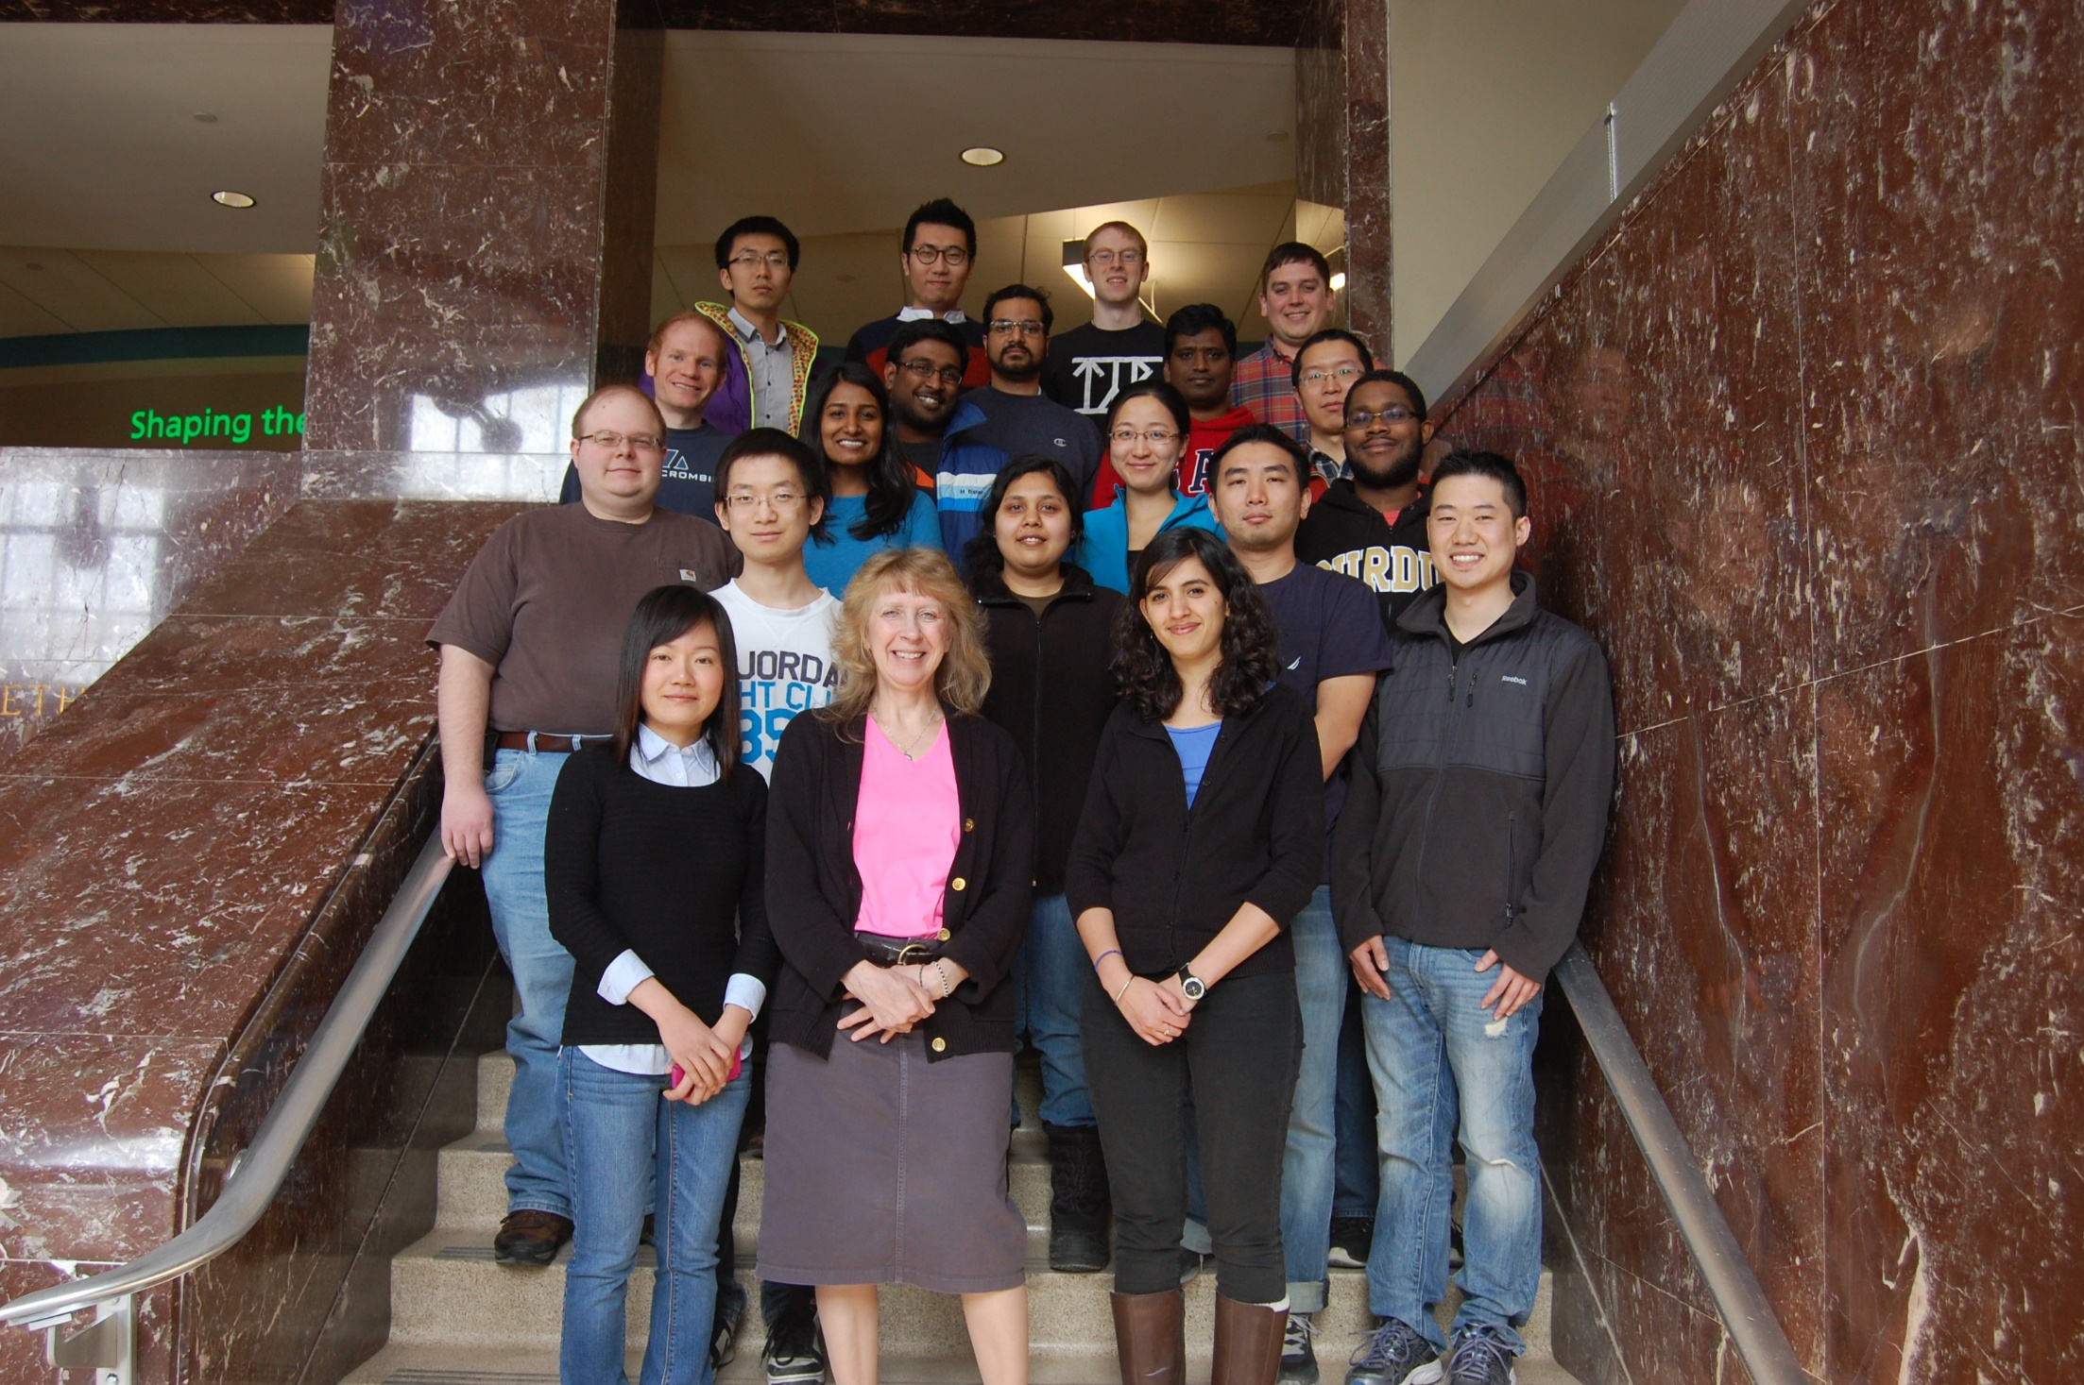

TAs: office hours by appointment
Rashmi Kumar
Xin Ma
Yuyang Zhang

Slide 5
LECTURE SLIDES will be posted on Blackboard
before each lecture.
Your first graded HOME WORK assignment will be given next week. It is due a week later. We use Sapling Learning: http://saplinglearning.com
RECITATIONS will be on assigned times on Tuesdays and Thursdays.
Graded QUIZZES will be given on some Friday lectures and some recitations.

Slide 6
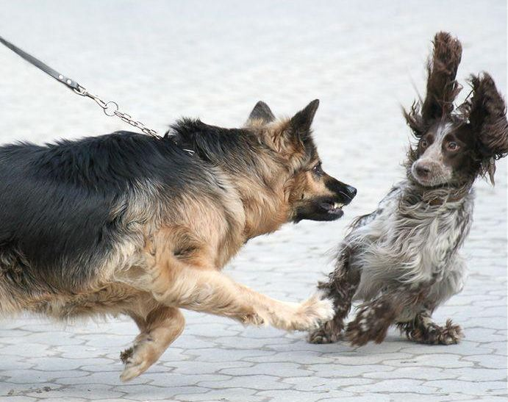
EXAMS are based on lectures, quizzes, recitations and homework!
February 11, March 8, and April 6, all at 6:30 pm in PHYS 112, and during finals week

Slide 7


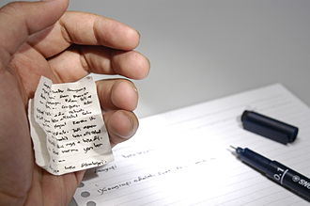




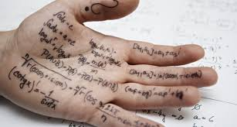
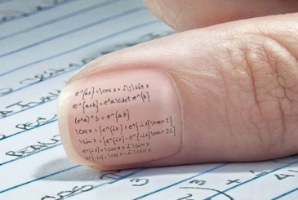
Cheating can END your academic career – do not do it!

Slide 8
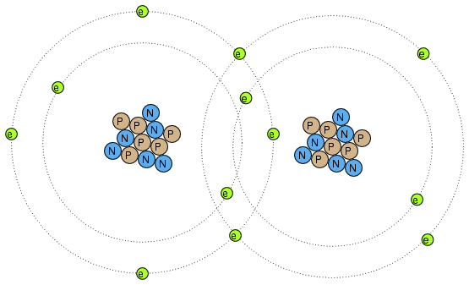
Simplified picture of two covalently bonded carbon atoms
N = neutron
P = proton
e = electron

Slide 9
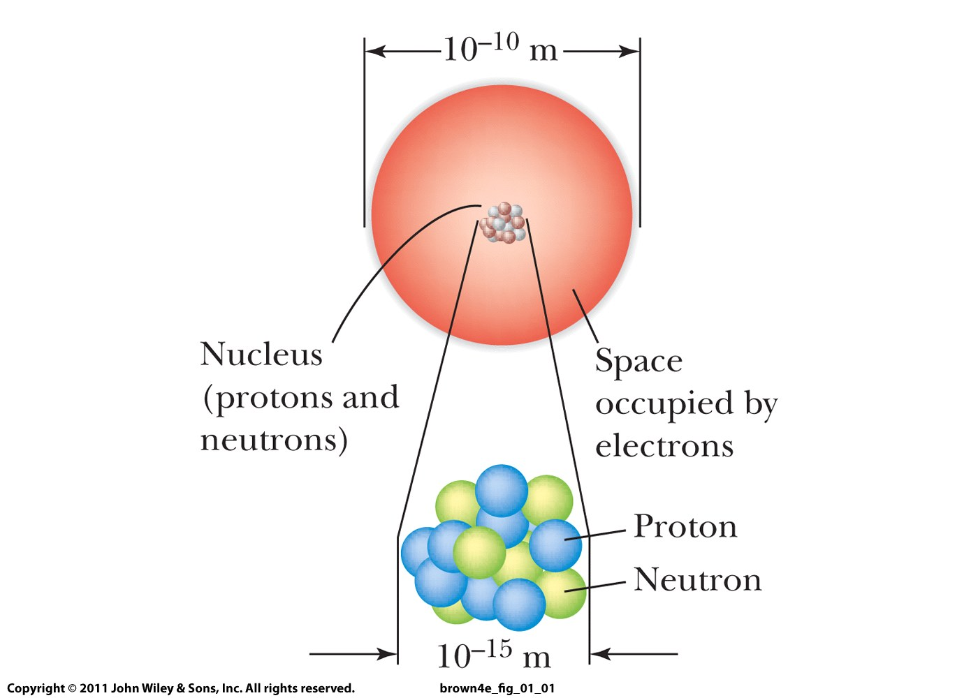
Lecture 1: Electronic structure of atoms

Slide 10
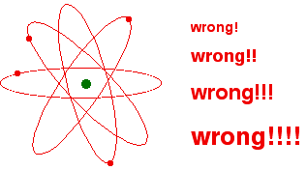

Slide 11
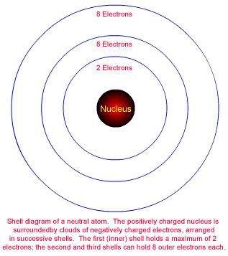
SHELLS

Slide 12
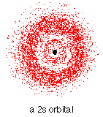
Each shell contains one s-orbital
Maximum 2 electrons

Slide 13
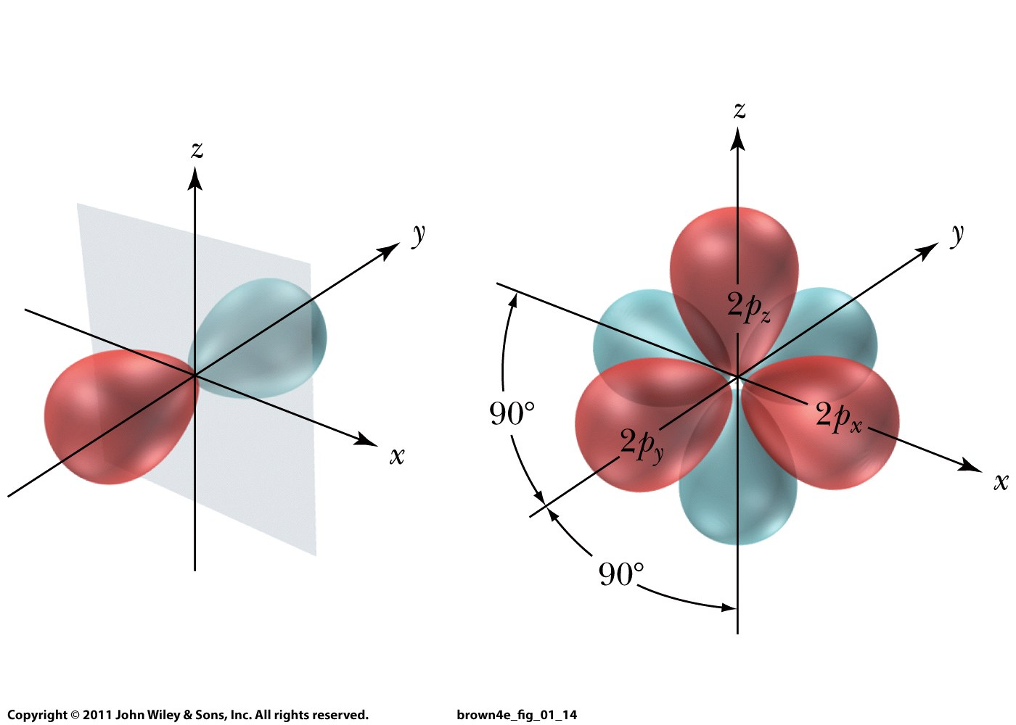
Each shell above first contains 3 p-orbitals
Maximum 2 electrons each

Slide 14
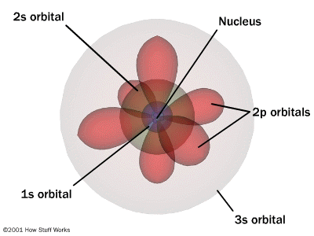
Quantum numbers: energy states and locations for electrons
Principal quantum number (n): main energy level (shell), distance from nucleus
Magnetic quantum number (m_{l}): orbital orientation; values; values for p orbital -1, 0, +1
Subshell: Orbital
Quantum number (l):
region in space an p_{y}, p_{x}, p_{y}
an electron is most
likely located
l = 1 for 2p orbital Electron spin magnetic quantum number (m_{s}):
+½ or -½: up/down
n = 1
n = 2
n = 3
l = 0 for 1s orbital
14

Slide 15
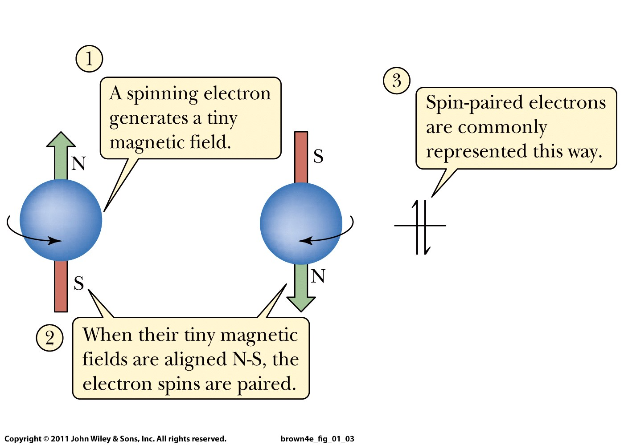

Slide 16
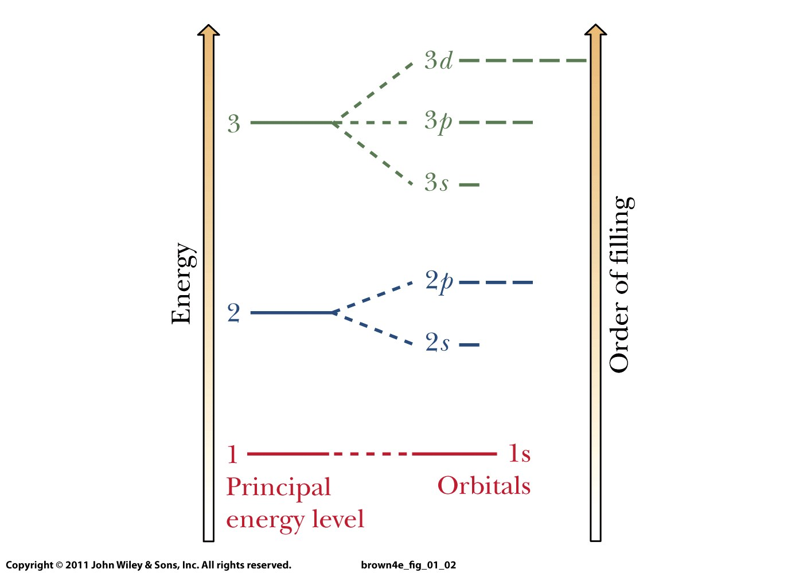
Rule 1: Orbitals fill from lowest energy to highest energy.
Rule 2: Only two electrons per orbital, spins must be paired.
Rule 3: For a set of orbitals with the same energy, add one electron in each before a second is added in any one.

Slide 17
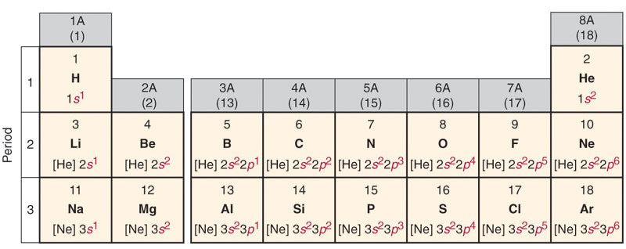
Cl :
1s²
2s²
2p⁶
3s²
3p⁵
[Ne] 3s² 3p⁵
condensed electron
configuration
Core electrons
Valence electrons:
determine elements’
chemical properties!
1s
2s
2p
3s
3p

Slide 18
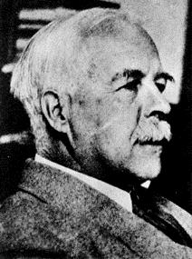
Gilbert Lewis, 1875-1946

Slide 19
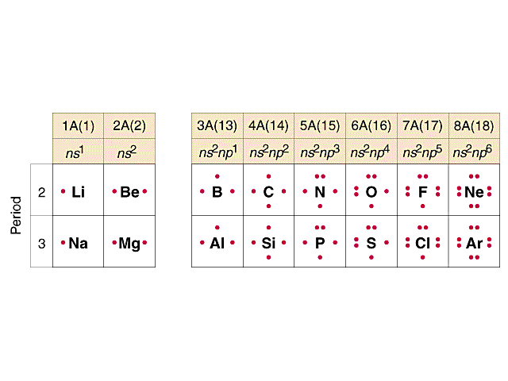
Lewis electron-dot structures
Number of dots = number of valence electrons

